Slide 1
Web Development 1
HTML5

Slide 2
HTML5
The term HTML5 covers a family of web technologies currently being specified by the W3C and being used in various stages by browsers vendors
What is commonly referred to as HTML5 is often a combination of HTML5 markup/features, CSS3 style and JavaScript
Understanding the difference is important for a technical audiences and less so for non-technical audience

Slide 3
HTML5
The HTML5 core is a specification that includes documentation of the elements used to build web pages as well as additional technologies such as Offline storage and Drag and Drop
A user friendly version of this specification is located at:
http://developers.whatwg.org
The HTML5 family includes the core plus associated technologies such as Canvas, Geolocation, CSS3 among others
The current foundation of the web is largely based on versions of HTML, CSS & JavaScript, with some exceptions, these have not been updated since 2000 and limit what can be accomplished easily by designers and developers

Slide 4
HTML5
HTML5 provides a foundation that is better suited for web applications and for creating optimized websites for both desktop and mobile devices
HTML5 accomplished this through a combination of improved syntax and other new features
HTML5 provides support for multimedia without the need for:
a browser plug-in,
offline data storage,
a native graphical format (Canvas),
updated capabilities for web forms and much more
Steve Jobs

Slide 5
HTML5 Syntax
The rules for HTML5 are less strict than either HTML4.0 or XHTML 1.0
HTML5 is NOT case sensitive: Upper and lower case tags are allowed, the page will still validate however it is good programming practices to go with either upper or lower case
The closing tags for elements are not always required.
ALWAYS CLOSE YOUR TAGS
Attribute quotes are optional:
<img src = AIT-Logo.png alt = ait home page>
<img src = “AIT-Logo.png” alt = “ait home page”>
One result of these rules is that HTML5 documents are backward compatible with older browsers
However inconsistency in your code will lead to errors

Slide 6
HTML5 Syntax
The DOCTYPE for HTML5:
<!DOCTYPE html>
HTML5 contains the majority of tags found in both HTML4.0 and XHTML1.0
The most notable new elements are categorized as section elements
The W3C explains section content as “….defining the scope of headings and footers.”
The four new elements in this category are
<article>
<aside>
<nav>
<section>
The <header> and <footer> elements are also new, but are technically considered Flow content, not Sectioning content

Slide 8
HEAD Elements: Title
Contains information about the web page rather than the content on the page
The <title> tag is used by search engines for search engine optimization
SEO Guidelines (Search Engine Optimizer)
Always code a title tag in the head section.
The title should accurately describe the page’s content.
The title should include the one or two keywords that you want the page ranked for.
The title should be interesting enough to entice the reader to click on it when it’s shown in the search results for a search engine.
The title should be unique for each page in your web site.
Limit the length of your titles to around 65 characters because most search engines don’t display more than that in their results.

Slide 9

Title
<html lang=“en”>
<head
<title>Alaskan Malamute</title>
<link rel="icon" href="images/Missy.jpg" type="image/jpg" sizes="32x32">
</head>
</head>
Some older versions of IE will not display the icon unless it is uploaded to a server

Slide 10
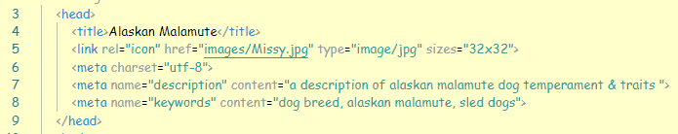
HEAD Elements: Meta
Another optional element that can be coded inside the HEAD tag
Attributes of the <meta> tag:
charset: A required tag in HTML5 stat specifies the type of character encoding to be used for the page. UTF-8 is the encoding that commonly used for the WWW
name: Specifies the type of metadata being added to the document. The values “description” and “keywords” can be used to specify content that’s used by some search engines
Content: Specifies the value to be used for the item specified by the name attribute

Slide 11
SEO Guidelines
Code the description metadata for each page of your web site.
The description metadata should summarize the contents of the page and be unique for each page.
The description metadata can also be longer than the title tag.
When the description is displayed in the search-engine results, it should encourage users to click on your link.
Code the keywords metadata for each page of your web site.
The keywords metadata should consist of no more than 10 keywords or phrases, and it should be unique for each page.

Slide 12
Headings & Paragraphs
Guidelines:
Use the heading tags to show the structure and importance of the content on a page.
Always start with an h1 tag and decrease one level at a time to show subsequent levels of importance.

Slide 13
HTML5 Semantic Elements (Structure)
header: The header for the page
section: A generic section of a document that doesn’t indicate the type of content
article: A composition like an article in the paper
nav: A section of a page that contains links to other pages or placeholders/anchors
aside: A section of a page like a slide bar that is related to the content that’s near it
footer: The footer of the page
Slide 13

Slide 14
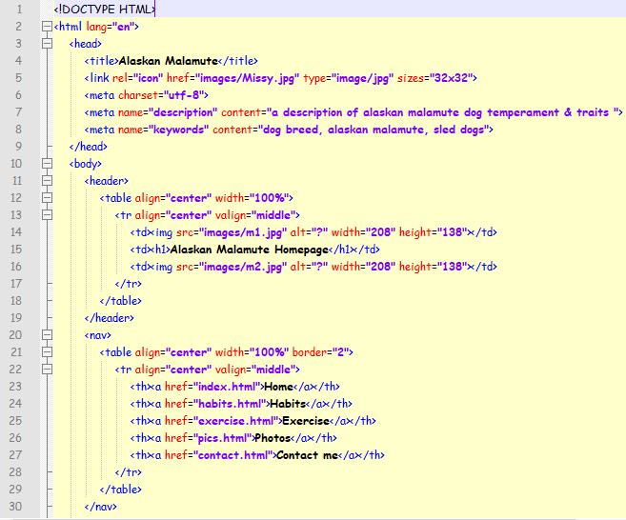

Slide 15
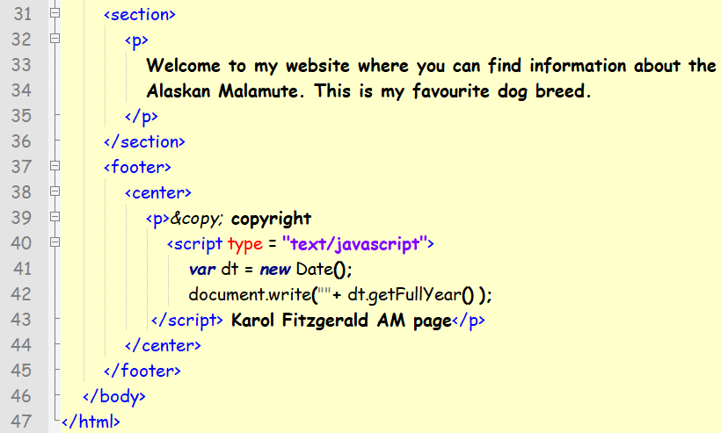

Slide 16
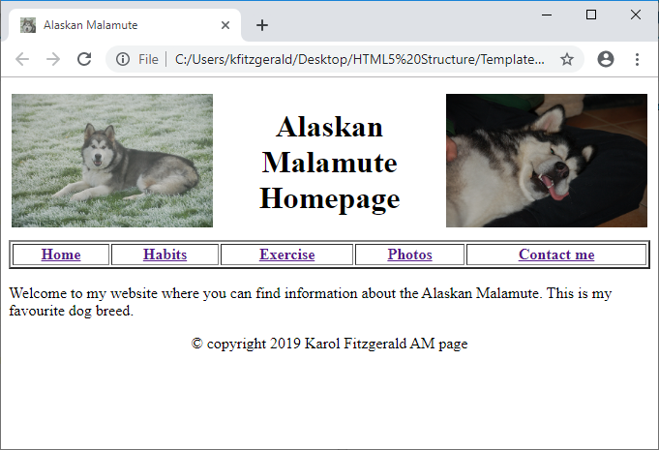

Slide 17
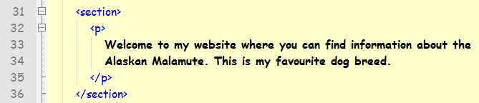

Slide 18
HTML5 & CSS3
A lot more can be accomplished with CSS3 in the coming weeks
You must get to terms with the tags covered to date
Additional attributes will be discussed with CSS3

Slide 19
Exercise 2
Using the semantic elements, create a new template website of your own design.
Use your own images, or images available on the internet
Save the template as Template2.html

